Slide 1
Race & the Criminal Justice System
Fall 2020 Professor Gaston
Agenda
Week 12
November 17, 2020
Review course schedule
Upcoming documentary
Lecture

Slide 2
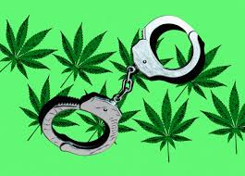
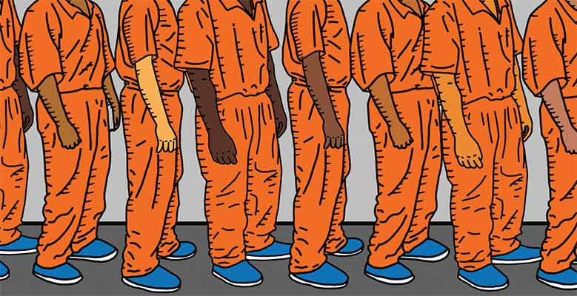
Race/Ethnicity, the War(s) on Drugs, & Mass Correctional Control
Tuesday November 17, 2020

Slide 3
History of the War(s) on Drugs
Watch the video here: https://m.facebook.com/story.php?story_fbid=1315515735147720&id=117200521645920
Race, ethnicity, and the criminalization of drugs

Slide 4
War on Drugs of the 1980s
Definition
The drug war regime
  Media
  Politicians
  Laws and policies
  Police
  Sentencing and punishment

Slide 5
Consequences of the War on Drugs
Exacerbated preexisting racial/ethnic disparities
Contributed to mass correctional control
Contributed to the prison boom
Mass criminal records

Slide 6
Mass Incarceration
What is it?
Mass correctional control
Unprecedented
  In the U.S.
  Globally

Slide 7
Causes of Mass Incarceration
Philosophical shift from rehabilitation to incapacitation/retribution
Shift from indeterminate to determinate sentencing
Mandatory minimums, truth-in-sentencing, three strikes
More reliance on prison, less reliance on parole
War on drugs
War on violent crime

Slide 8
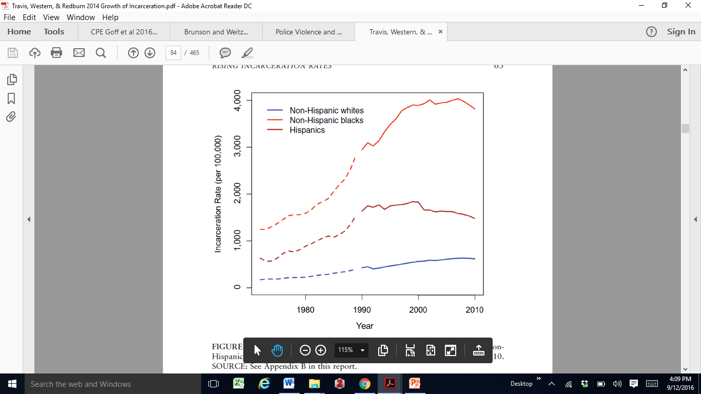
Race/Ethnicity & Mass Incarceration, 1972-2010

Slide 9
Why is Mass Incarceration Problematic?
Racial caste system
Racialized collateral consequences
Prisons are criminogenic
  Importation of prison culture to communities
Perpetuates crime
Perpetuates racial and socioeconomic inequality

Slide 10
Correctional Control in the U.S. Today

Slide 11
1. Race/Ethnicity & Jails
Functions of jails

Slide 12
2. Race/Ethnicity & Probation
Function of probation

Slide 13
3. Race/Ethnicity & Prison
Function of prison

Slide 14
Race/Ethnicity & Imprisonment Rates, per 100,000

Slide 15
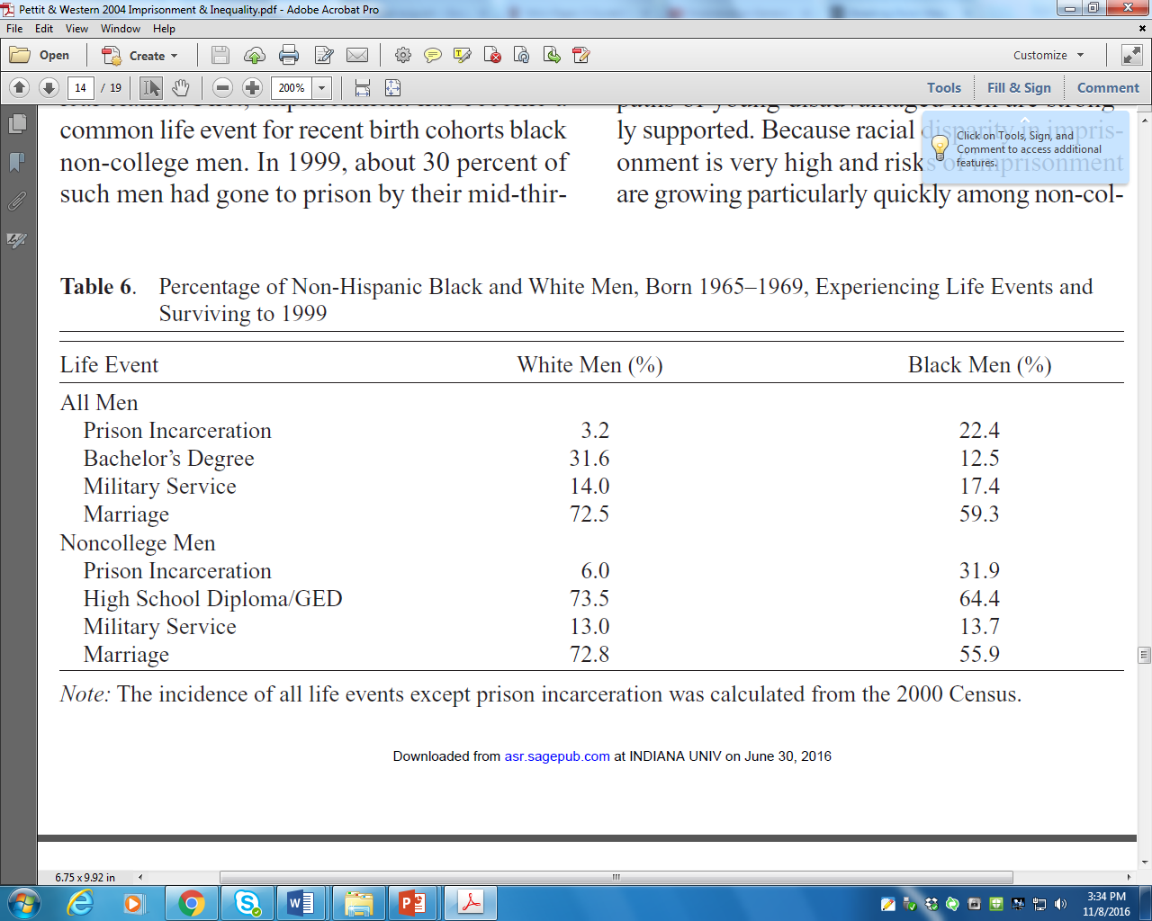
Race & Lifetime Risks of Imprisonment

Slide 16
Causes of Race Disparity in Prison
Race differences in violent offending
Differential law enforcement practices
Cumulative criminal justice disadvantage
  Case processing and earlier decisions
Interpersonal racial discrimination
  Explicit or implicit

Slide 17
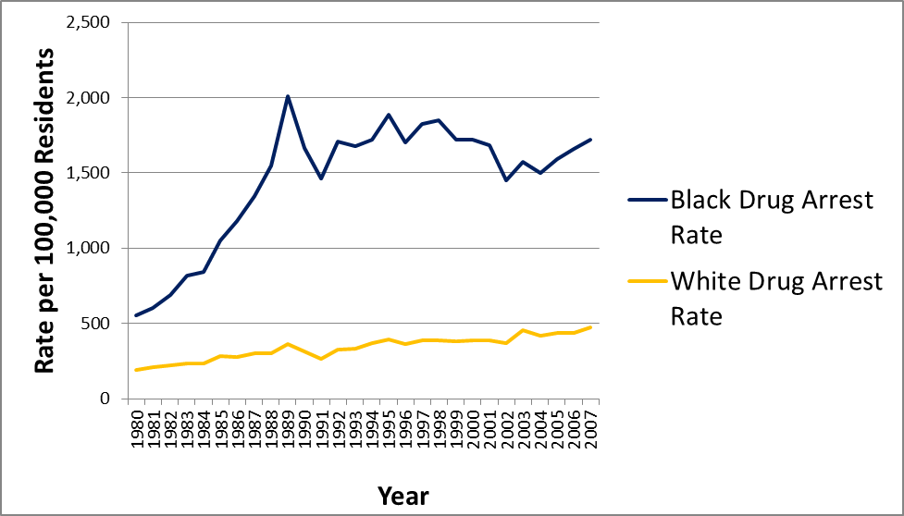
Causes cont’d
Systemic racial discrimination
  War on Drugs
U.S. Rates of Adult Drug Arrests by Race, 1980-2007

Slide 18
4. Race/Ethnicity & Parole
Function of parole

Slide 19
Race/Ethnicity & Correctional Control

Slide 20

“13th” Netflix Documentary

Slide 21
Questions???
Notes:
Discussion Forum for Week 12 Questions

